Slide 1
Microsoft //build/
Matthew Burleigh
Senior Developer, Pandora Jewelry
@svdreamline
March 30 – April 1, 2016, San Francisco, CA
Notes:
https://channel9.msdn.com/Events/Build/2016

Slide 2
Pandora //build/ Team
Mark Sengamalay
Phillip Kennedy
Eric Rubin
Stan Bice
Todd Steele

Slide 3
Xamarin is Free!!!!
Notes:
https://channel9.msdn.com/Events/Build/2016/KEY02#time=18m32s

Slide 4
Xamarin Tools
Free for all versions of Visual Studio
Open Source
MIT License
iOS Emulator for Visual Studio
Xamarin joins the .NET Foundation
Workbooks (https://developer.xamarin.com/guides/cross-platform/workbooks/)
Inspector (https://developer.xamarin.com/guides/cross-platform/inspector/)
Notes:
https://www.dotnetfoundation.org/blog/welcoming-xamarin-to-the-net-foundation
http://open.xamarin.com/
http://forums.dotnetfoundation.org/

Slide 5
Xamarin is Free!!!!

Slide 6
.NET Core & ASP.NET Core 1.0
RC2 available now
Tooling is considered as “preview 1”
RTM by end of June
Tooling will be considered “preview 2”
Tooling will RTM with Visual Studio “15”
Preview 2 available at https://www.visualstudio.com/downloads/visual-studio-next-downloads-vs
z

Slide 7
.NET Core 1.0
.NET on all platforms
Windows, Linux, OSX
Android & iOS (Xamarin)
.NET on all devices
Raspberry Pi/Arduino ➔ 32 core/448GB RAM ➔ distributed cluster (service fabric/Akka)
.NET on any cloud
Azure, EC2, GDE, Docker
Also – Docker on Windows!!! Woo hoo!!!
Notes:
https://dotnet.github.io/

Slide 8
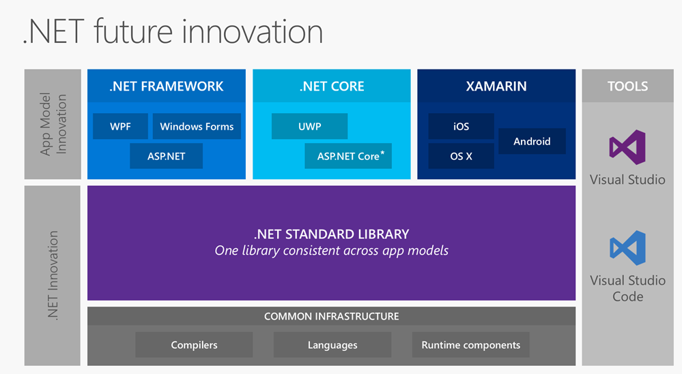
.NET Core 1.0
http://www.hanselman.com/blog/AnUpdateOnASPNETCore10RC2.aspx
Notes:
https://dotnet.github.io/

Slide 9
ASP.NET Core 1.0
Built on a new .NET Execution Environment (DNX)
Runs on framework 4.6 & Core 1.0
Completely OSS when running on .NET Core 1.0
Unified controller classes
Modular, composable middleware
Routes can include only necessary support modules (think non visible)
Includes support for package managers other that NuGet (Bower, NPM)
Event bindings for build tasks (Gulp)
Tag helpers simplify markup
Notes:
<%= [html encode some code output here] %> ➔ <%: [code something here] %> ➔ @ [code something here] ➔ asp-for

Slide 10
Bots!
Conversation as a platform
Facebook bots
Google Allo

Slide 11
Machine Learning
LUIS
Cortana Intelligence Suite
Cognitive APIs
CRIS

Slide 12
Azure
IoT
Service Fabric
Azure Functions
Serverless compute
Trigger on events in Azure + external events
Pay per execution (based on execution time & function space)
Code in C#, Javascript, Python, PHP, Bash, Batch, Powershell
Expose as HTTP API endpoints (maybe Flow is built on this)
Notes:
Azure functions:
first 1 million requests free
first 400k GB/Sec free
https://azure.microsoft.com/en-us/documentation/services/functions/

Slide 13
Windows 10 Anniversary
Ink Space
Bash (Windows Subsystem for Linux)
Command line tools only
64 bit only
Improved Cortana
Available on lock screen
Integration with phone apps (Android & iOS)
Convert existing windows apps
Windows 10 free upgrade offer ends 7/29/2016

Slide 14
Hololens

Slide 15
Office
Graph API
http://graph.microsoft.io/en-us/
Modern Office Addins
XML Manifest
Web Application (ex. Boomerang)

Slide 16
Xbox Dev Mode

Slide 17
Power BI
Build 2016 Videos on Channel 9 –
Adding Power BI Data Experiences to Your Applications
https://channel9.msdn.com/Events/Build/2016/B804
Integrating Power BI into Your Own Applications – Featuring Real World Demos
https://channel9.msdn.com/Events/Build/2016/T685
Developing Custom Visuals for Power BI– Deep Dive
https://channel9.msdn.com/Events/Build/2016/P434

Slide 18
Power BI – Visuals Gallery
Download and use additional visuals, developed by the community
https://app.powerbi.com/visuals/

Slide 19
Power BI – Custom Visuals
Develop your own visuals and share them with the community
Framework and code is available on GitHub
https://powerbi.microsoft.com/custom-visuals/
https://github.com/Microsoft/PowerBI-visuals

Slide 20
Power BI - Embedded
embed a report into an app, using a REST API

Slide 21
Power BI - Embedded
uses an IFrame in the browser

Slide 22
Power BI - Embedded
cache the data to keep costs down

Slide 23
Power BI - Resources

Slide 24
DocumentDB
Build 2016 Videos on Channel 9 –
Delivering Applications at Scale with DocumentDB, Azure's NoSQL Document Database
https://channel9.msdn.com/Events/Build/2016/B840
Modeling Data for NoSQL Document Databases
https://channel9.msdn.com/Events/Build/2016/P468

Slide 25
DocumentDB – Case Study
Used by the #1 app on the iTunes App Store

Slide 26
DocumentDB – Backend Architecture
Using the right tool for the right job
Choose the tools for performance
With non-structured data, relational database schemas creates difficulties for scalability

Slide 27
DocumentDB - Scalability
Use techniques to scale the data:
Partitions
Secondary indexes

Slide 28
DocumentDB - Scalability
Design the data and API calls to utilize the scalability features

Slide 29
DocumentDB - Resources

Slide 30
Bing Maps
Build 2016 Videos on Channel 9 –
Maps: Microsoft’s Modern Mapping Platform
https://channel9.msdn.com/Events/Build/2016/B867

Slide 31
Bing Maps – V8 SDK
Lots of improvements

Slide 32
Bing Maps – V8 Key Features
Blue – V7 key features
Green – V8 key features

Slide 33
Bing Maps – Call to Action

Slide 34
Questions?
Slides and notes available online at http://bit.ly/baltomsdn201605

